Slide 1
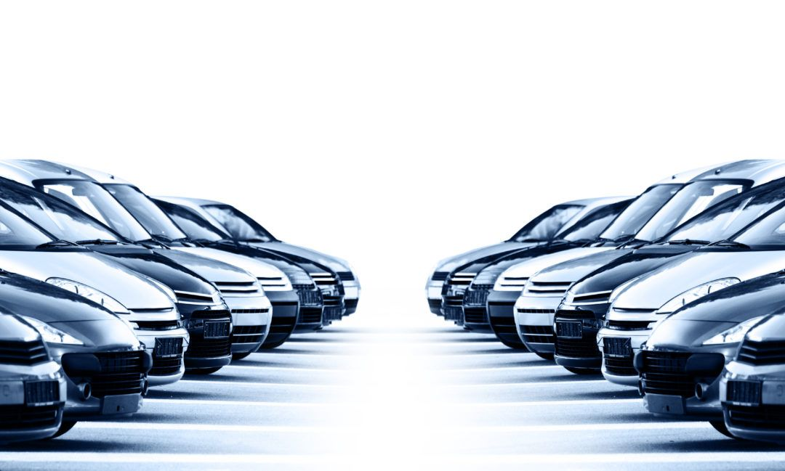


JIMMY
Haimov Nir
Haimov Erez

Slide 2
The problem
Every day thousands of drivers around the world come across car problems that they don't know what they mean and what the solution to the problem is, sometimes even while driving.
All the vehicle's information is in the vehicle manual, which has many pages filled with information, and sometimes it’s difficult for people to find what they need, so they usually don't do it, especially if the problem appears while driving.
Other ways to solve a car problem or to get information about it today are to call someone, search a lot on the Internet, go to a garage and more.
All of the ways above can take a very long time, can rob the driver of resources (money, a day off, free time, etc.) and can yield unreliable information, which can also cause damage to the vehicle.

Slide 3



Project goals
Receiving a quick response with step-by-step voice guidance and a visual aid
Understanding the sentences the user says, analyzing keywords, understanding the need for the question/problem
A conversation with the driver in which the driver can explain the help they wish to receive using their voice

Slide 4


Technologies in use
Code = Flatter-Dart.
Database = Firebase.

Slide 5
System functionality
Application interface language - English default.
At the first login to the application, the following actions will be performed:
Creating a user using a Google or Facebook account (and more if possible).
Disclaimer screen - it will not be possible to use the application without approval of the terms of use.
Defining the user's personal information (mandatory fields):
Application interface language, speech-language, vehicle type (Toyota Corolla, Fiat Ibiza, Mazda 3, etc.), year of manufacture.
All data entered into the application will be saved on the created account.
The application will ask, visually and audibly "How can I help?".
It will tell the application the problem that needs to be solved (like a dashboard lamp turned on) or ask for general information (like how to change a tire).
The application will understand what was said by receiving keywords and searching them in the DB, understand what answer is needed to be given, and present it both audibly and visually through text and images.
The application will also have the option to change the voice in which the application speaks.

Slide 6
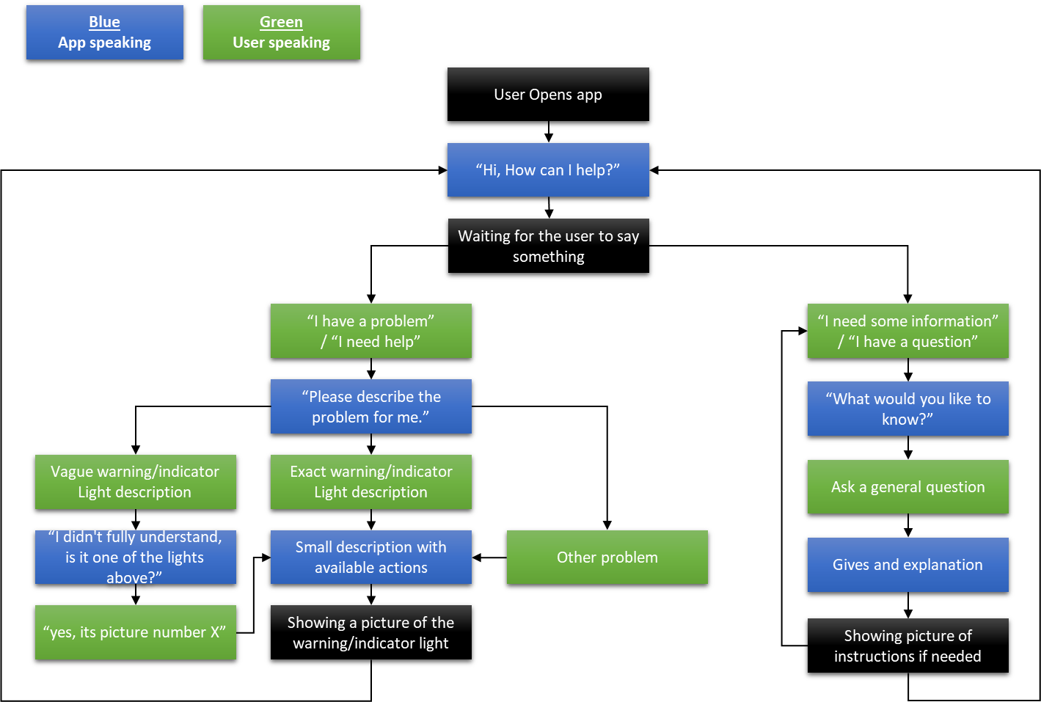
Flowchart

Slide 7
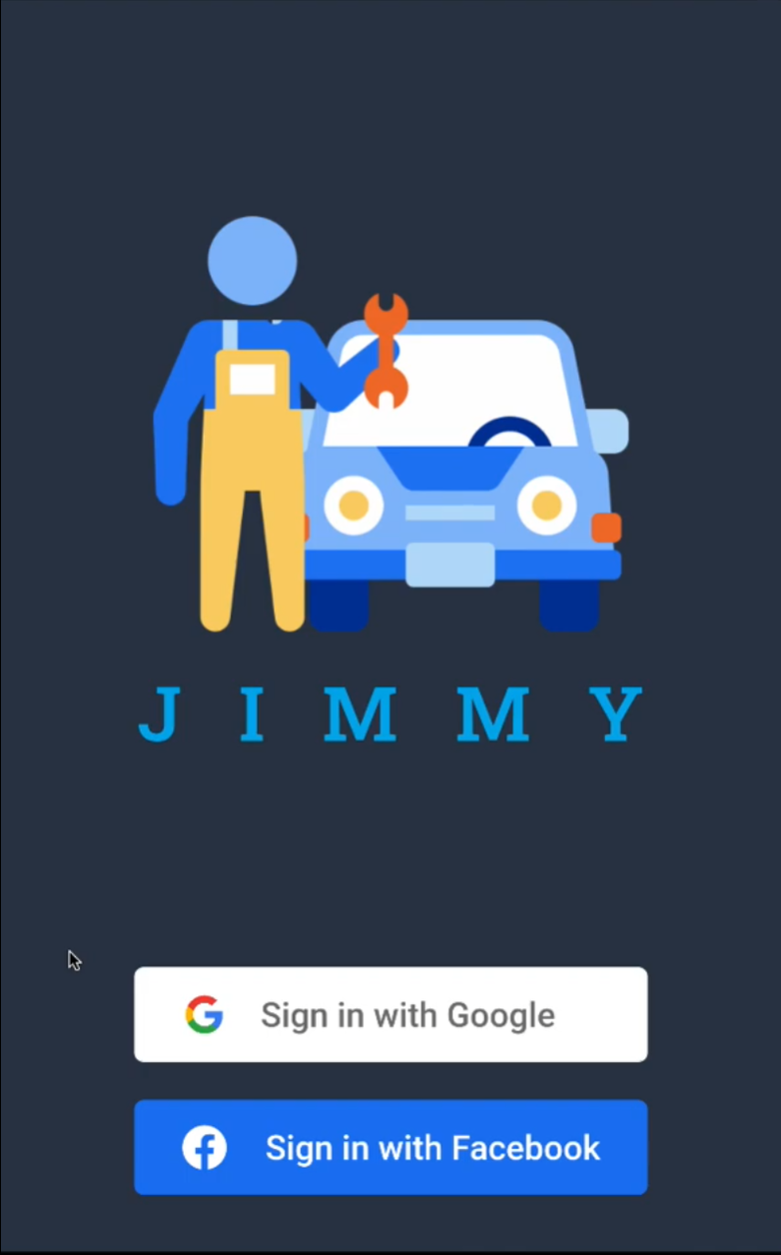
Login screen

Slide 8
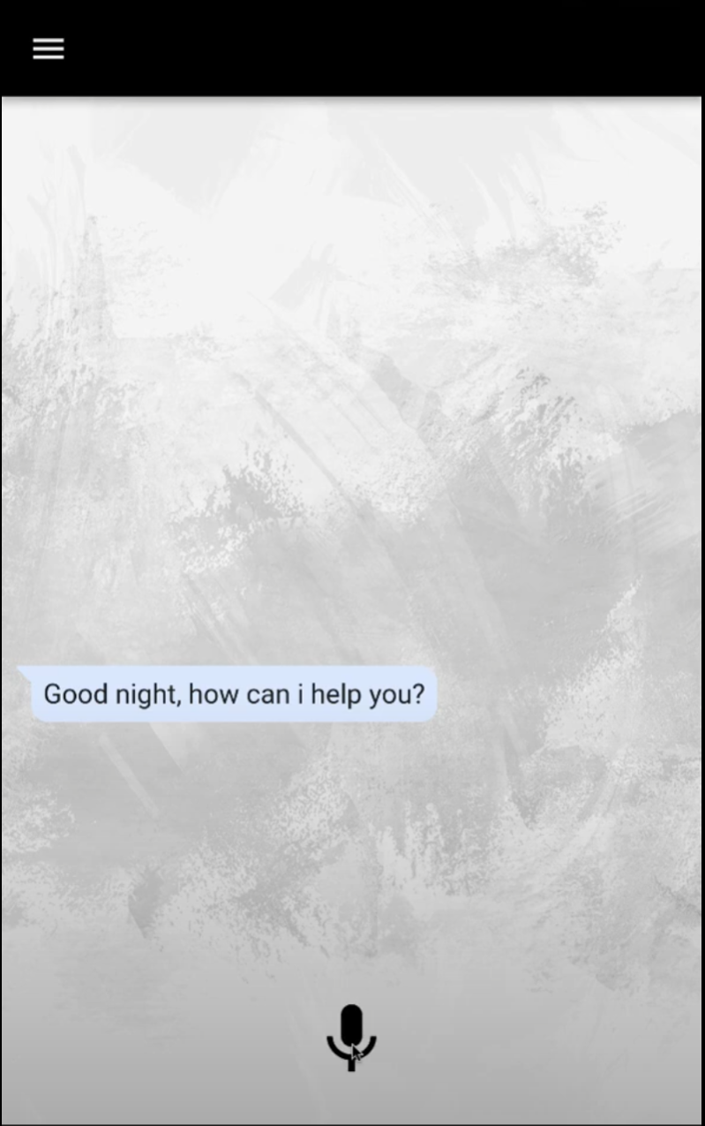
Start screen

Slide 9
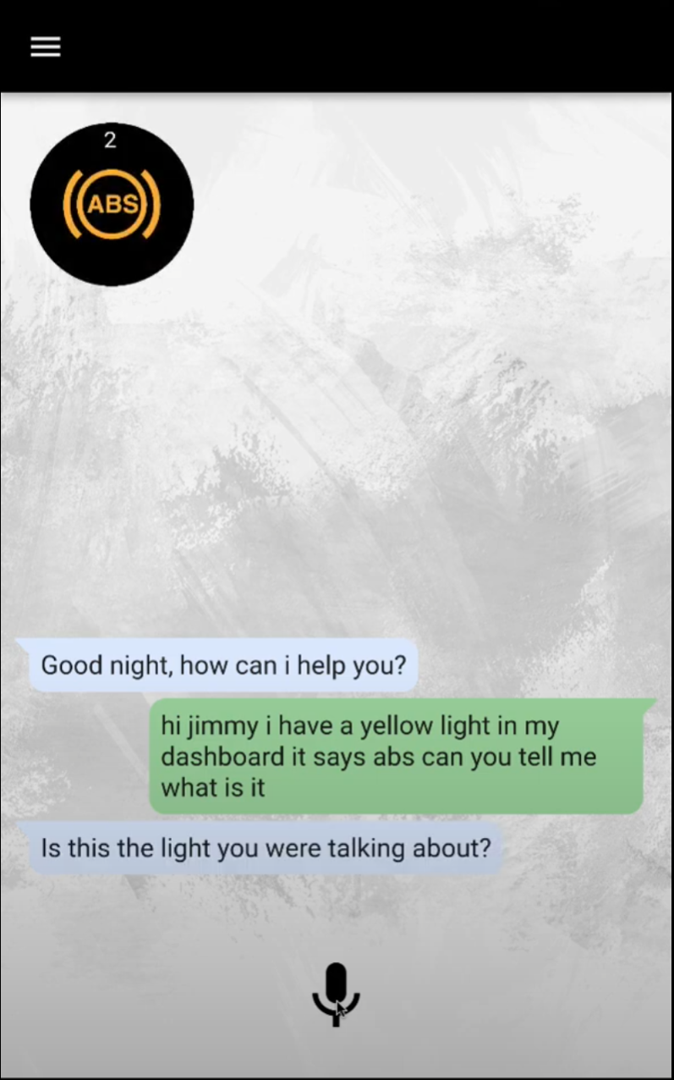
A question about a specific lamp

Slide 10
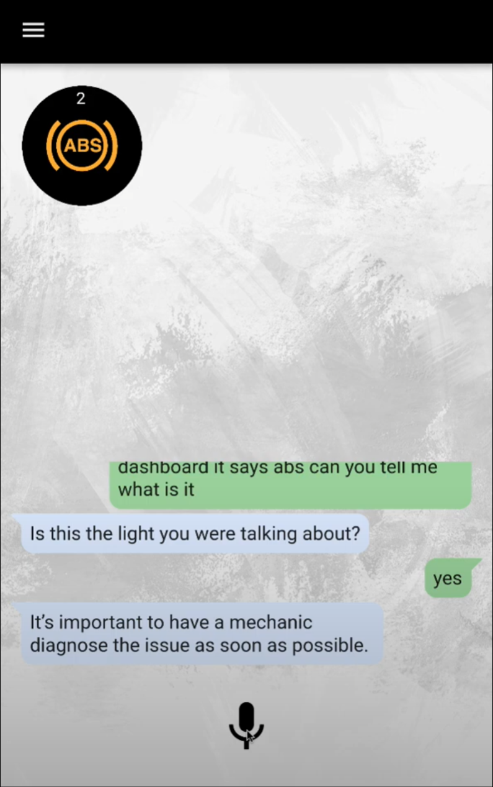
Verification of the problem and answer

Slide 11
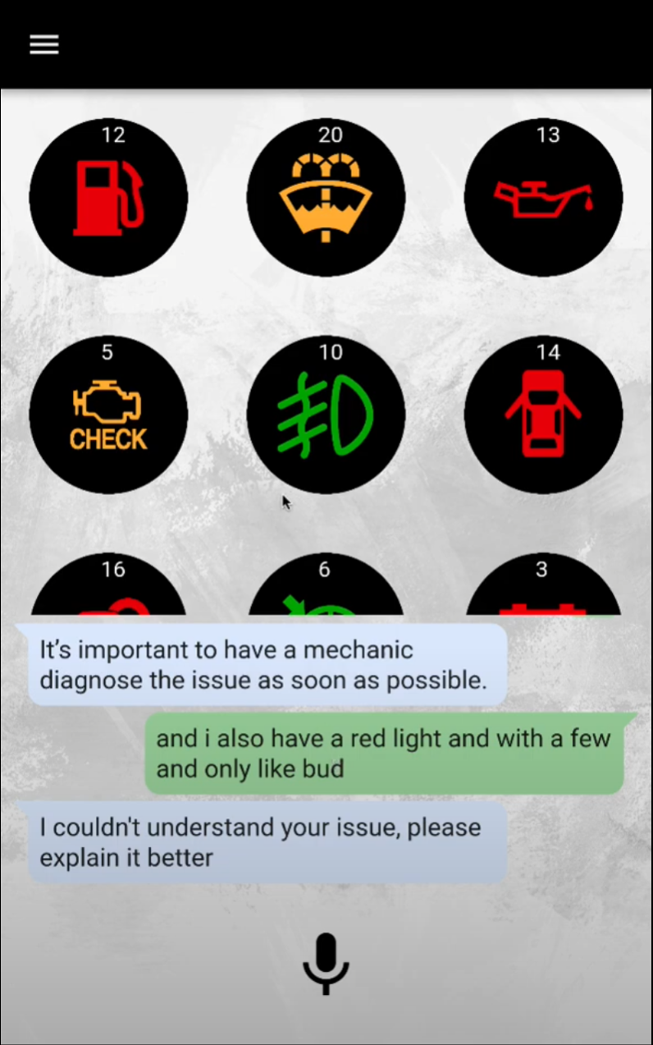
Unclear question

Slide 12
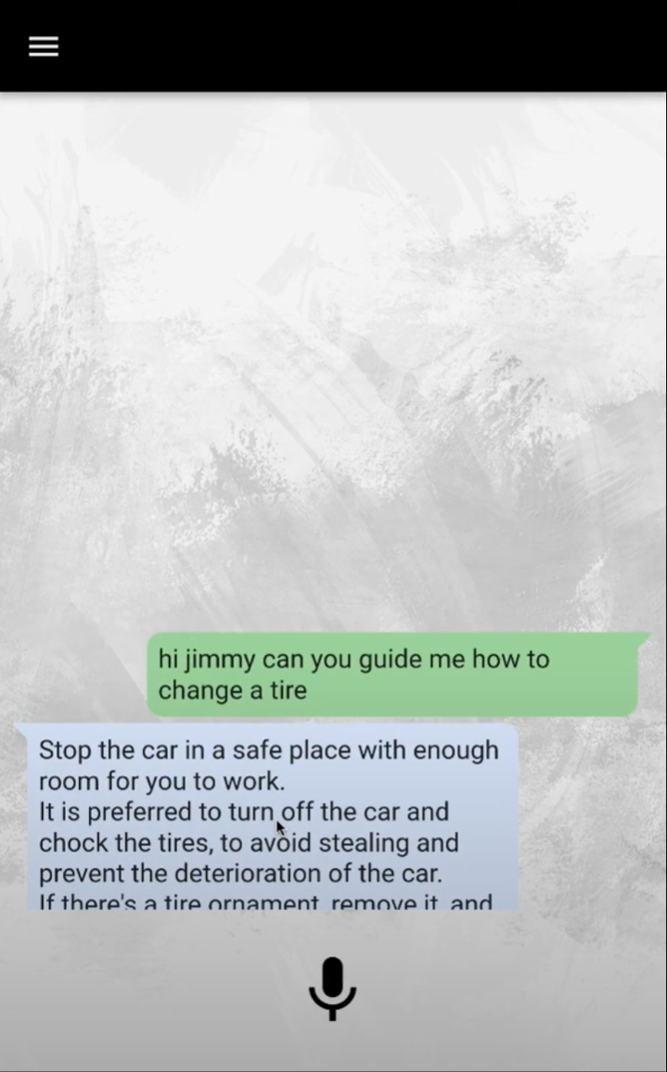
General help request for something

Slide 13
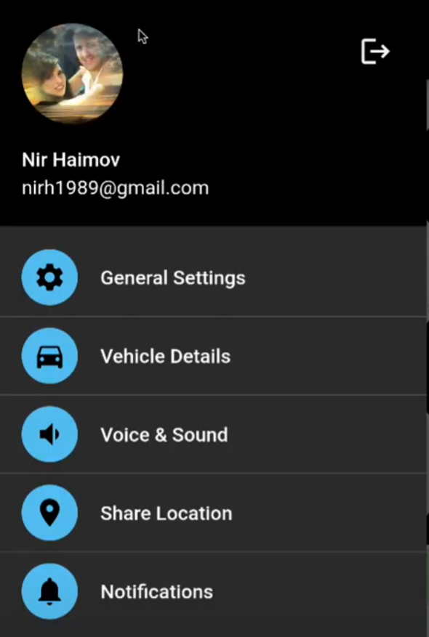
menu screen

Slide 14
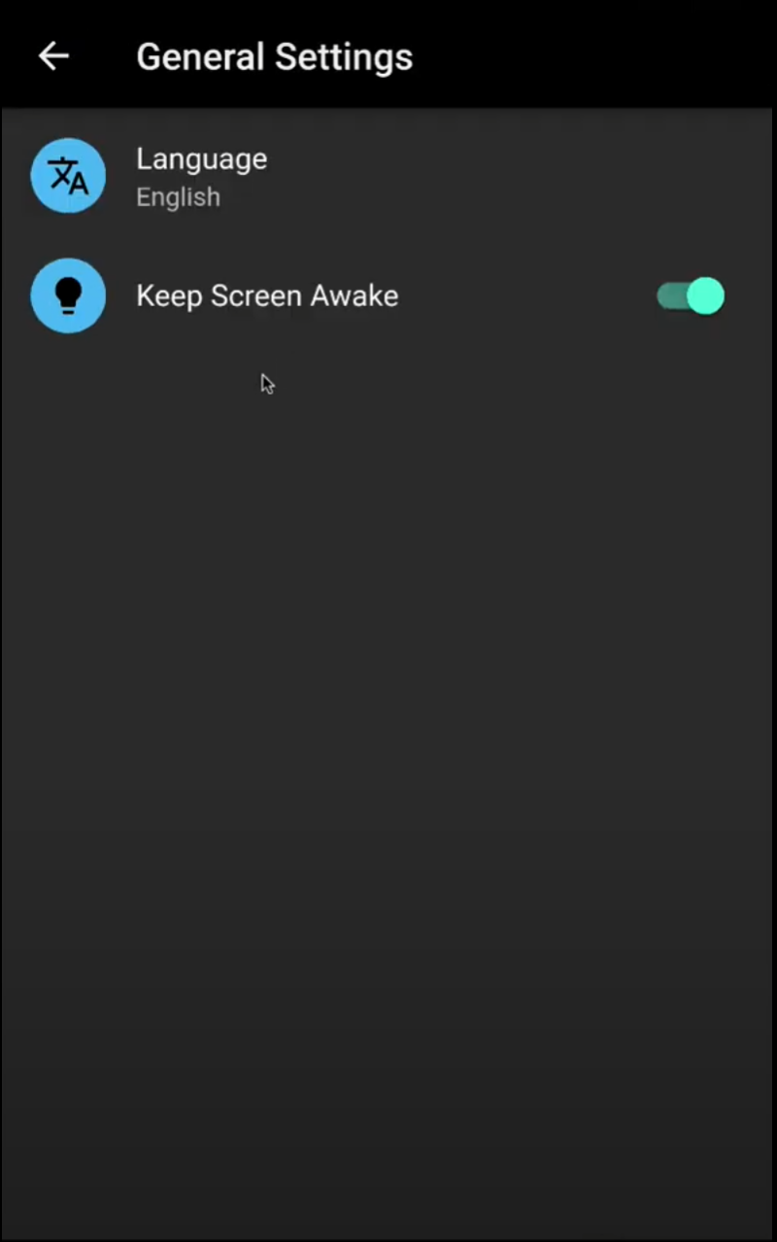
General settings screen

Slide 15
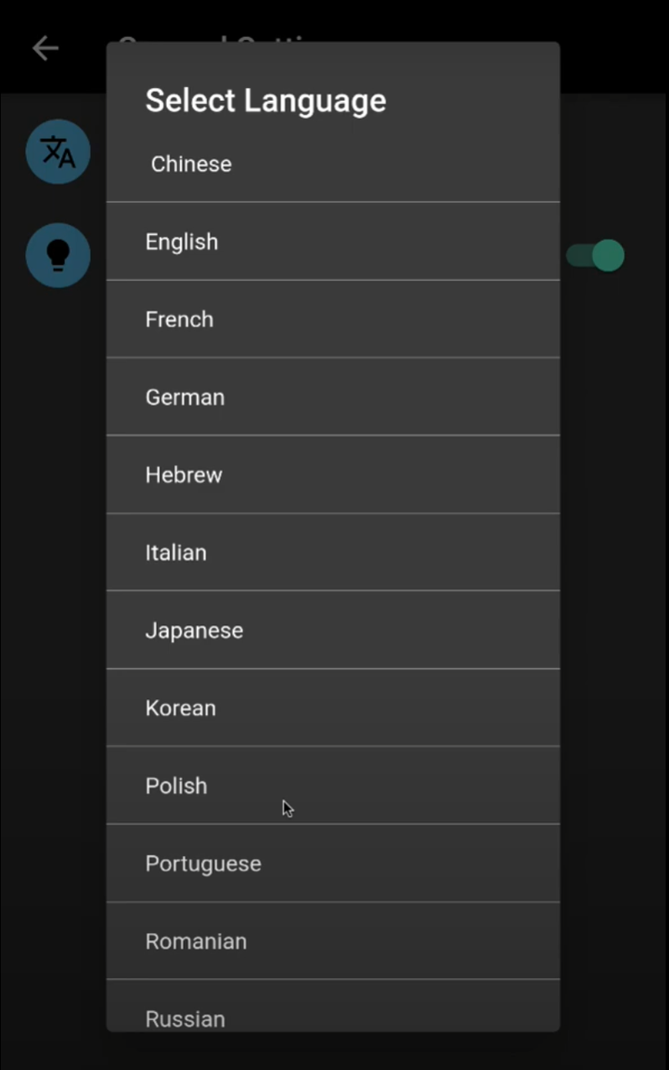
Language selection screen

Slide 16
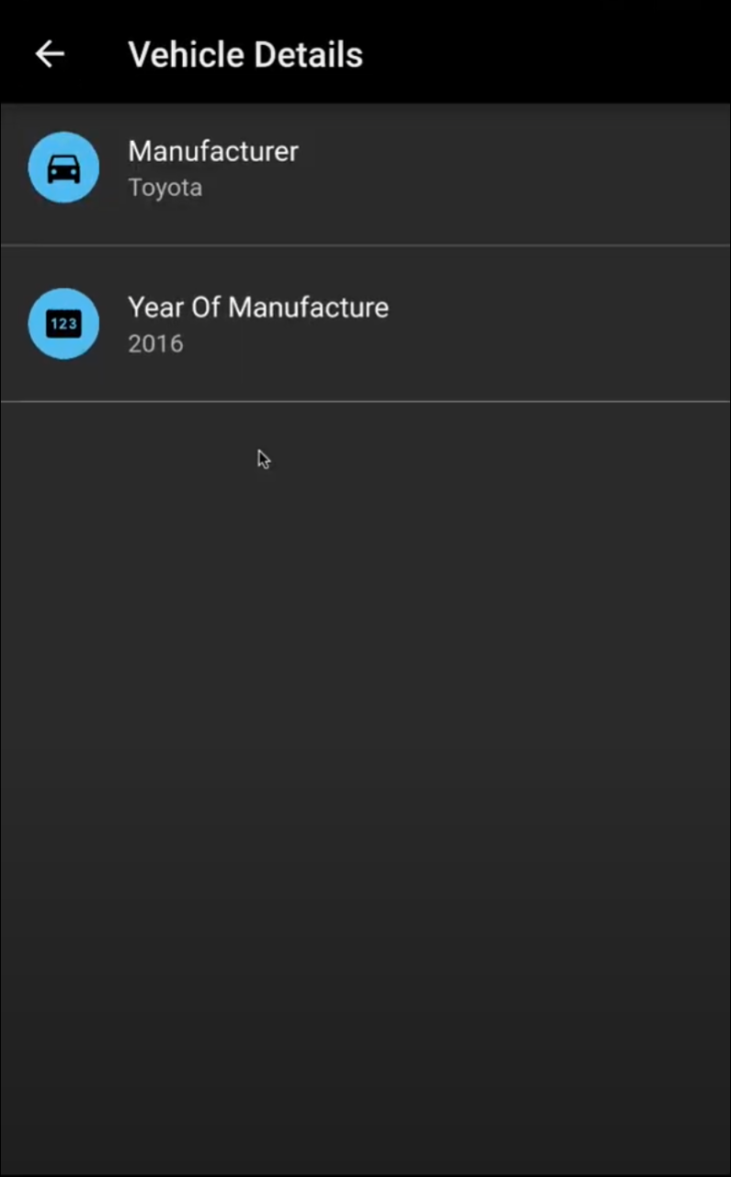
Vehicle details screen

Slide 17
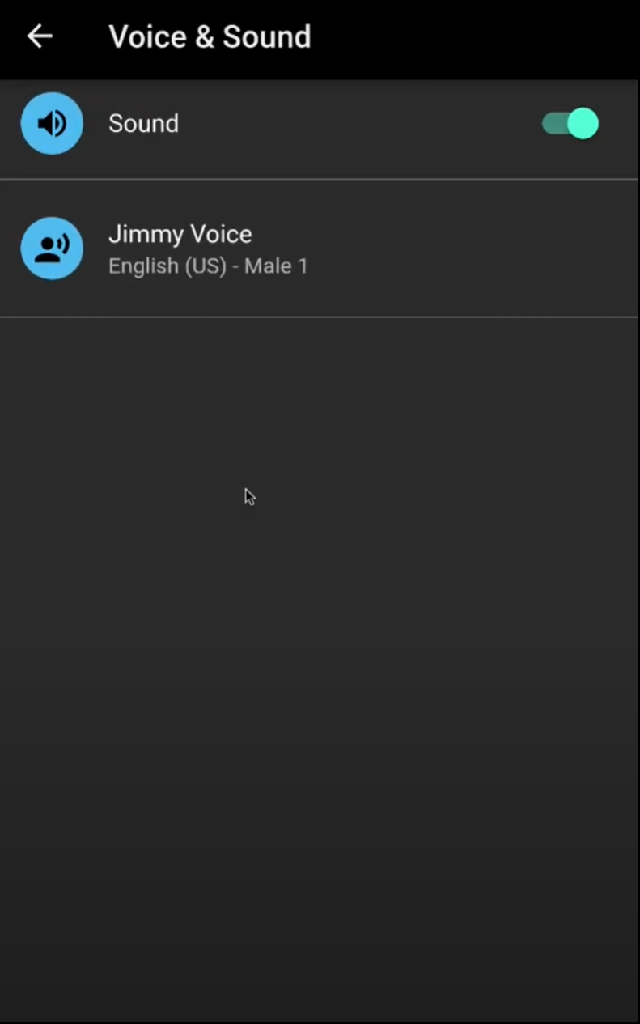
Sound and audio settings

Slide 18
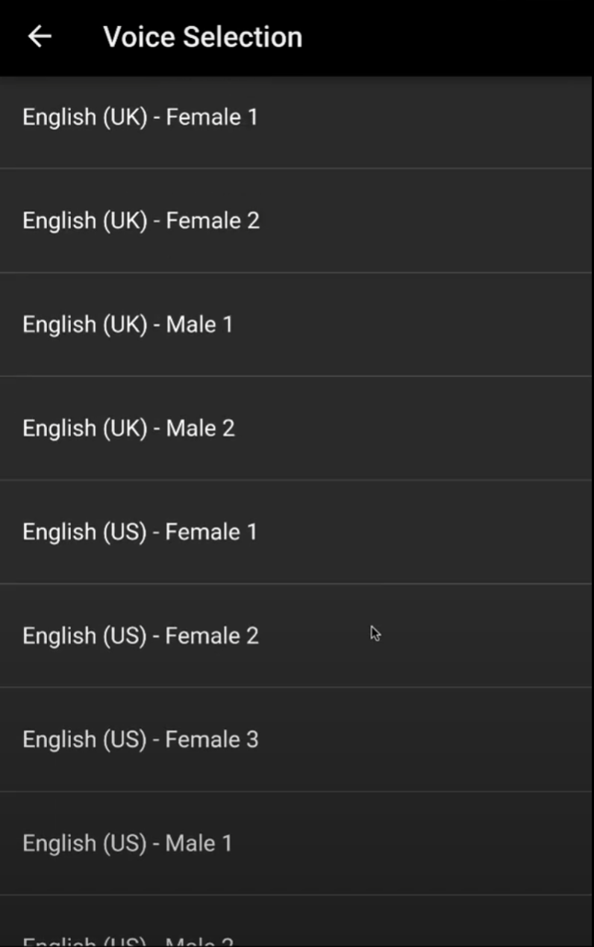
Voice Selection screen

Slide 19


